Slide 1


Control Flow
Nazrin Dolkhanova Sultanli
Programming and Computer Applications – 1

Slide 2



Agenda
Introduction
Statements and Blocks
If - Else
Else - if
Switch
while and for
Do-while
Break and Continue
Goto and Labels

Slide 3
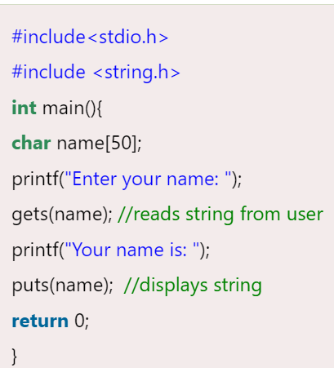
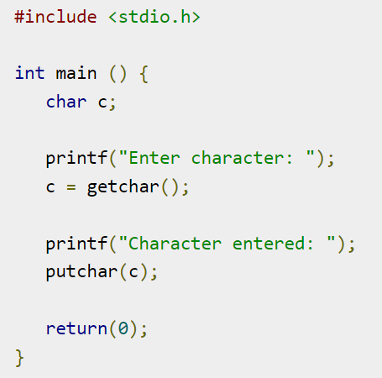
Introduction
The gets() function enables the user to enter some characters followed by the enter key. All the characters entered by the user get stored in a character array. The null character is added to the array to make it a string. The gets() allows the user to enter the space-separated strings. It returns the string entered by the user. It terminates its reading session as soon as it encounters a newline character.
gets( variable name );
This function returns str on success, and NULL on error or when end of file occurs, while no characters have been read.
The puts() function is very much similar to printf() function. The puts() function is used to print the string on the console which is previously read by using gets() or scanf() function. The puts() function returns an integer value representing the number of characters being printed on the console. Since, it prints an additional newline character with the string, which moves the cursor to the new line on the console, the integer value returned by puts() will always be equal to the number of characters present in the string plus 1.
int puts(char[])
The putchar(int char) method in C is used to write a character, of unsigned char type, to stdout. This character is passed as the parameter to this method.
int putchar(int char)
This method accepts a mandatory parameter char which is the character to be written to stdout.
This function returns the character written on the stdout as an unsigned char. It also returns EOF when some error occurs.
The C library function int getchar(void) gets a single character (an unsigned char) from stdin.
int getchar(void)
This function returns the character read as an unsigned char cast to an int or EOF on end of file or error.

Slide 4

Topic two
Control Flow

Slide 5
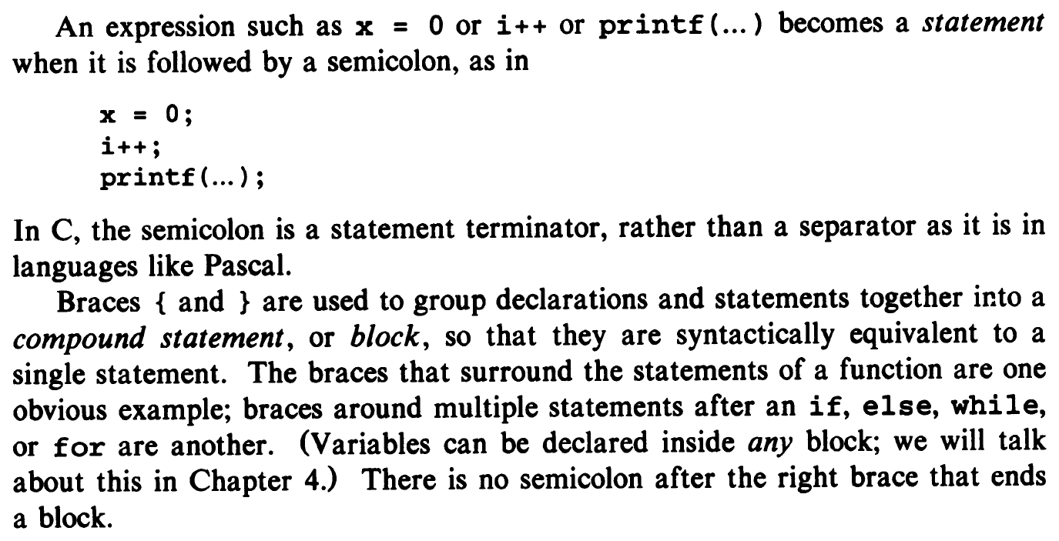
2.1 Statements and Blocks

Slide 6
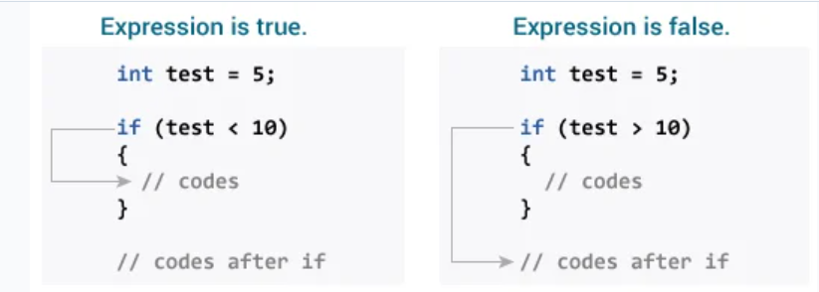
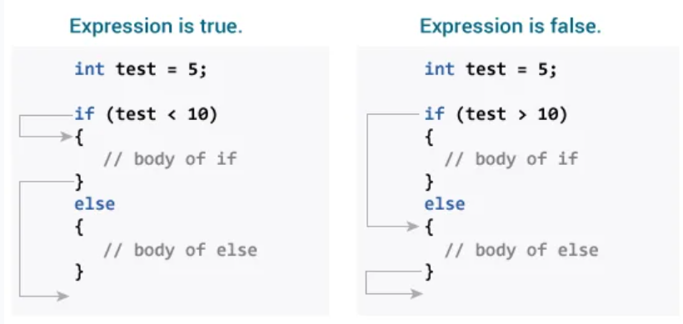
2.2 If - Else
The if keyword is followed by a set of parentheses (). Inside these parentheses, a condition is provided that evaluates to true or false:
If the condition evaluates to true, the code inside the curly braces {} executes.
If the condition evaluates to false, the code doesn’t execute.
if (condition) { // Statement1 — do something }
else { // Statement2 — do something else }
If condition is true, statement1 is executed. Then the program skips statement2 and executes any code statements following the if / else clause.
If condition is false, statement1 is skipped and statement2 is executed. After statement2 completes, the program executes any code statements following the if / else clause.
if (coin == 1) { printf("Heads\n"); }
else { printf("Tails\n"); } In the code above, if coin is equal to 1, the program outputs “Heads”; if it does not, then it outputs “Tails.”
Note: It’s either or — only one of them will execute!

Slide 7
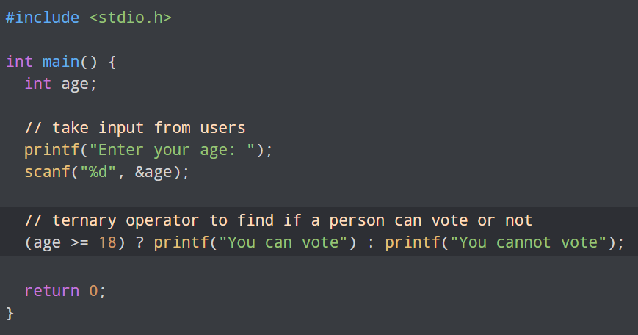
2.2 if-else: A ternary operator
A ternary operator looks like this:
condition ? do something : do something else;
The above example is exactly the same as:
if (condition) { // Do something } else { // Do something else }
This operator acts exactly like an if / else statement! For example, let’s take a look at the following statement:
if (a < b) { min = a; } else { min = b; }
The above if / else statement compares a and b and stores the smaller of the two inside the min variable. Let’s rewrite this as a ternary operator:
min = a < b ? a : b;
The ? marks the check for the condition, as if asking it as a question. If a is the smaller number, the condition passes with true, which executes the left-hand side of the : and stores a into min. If the condition was false, then the right-hand side of the : executes, which stores b into min instead.

Slide 8
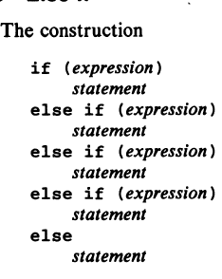
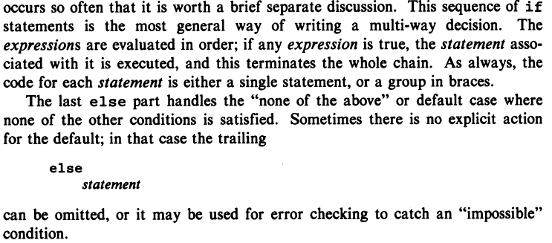
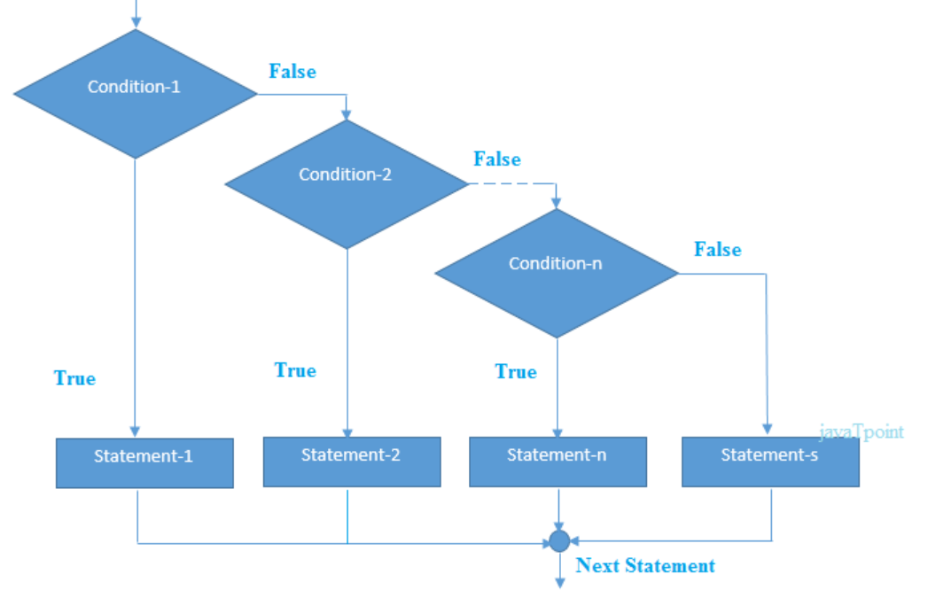
2.3 Else - if
The else if statement always comes after the if statement and before the else statement (if there is one). Like the else statement, else if statements are also always optional!
The else if then takes a condition, and you can have more than one of them. Here’s an example with three of them:
if (grade == 9) { printf("Freshman\n"); } else if (grade == 10) { printf("Sophomore\n"); } else if (grade == 11) { printf("Junior\n"); } else if (grade == 12) { printf("Senior\n"); } else { printf("Super Senior\n"); }
if (test expression1) {
// statement(s)
}
else if (test expression2) {
// statement(s)
}
else if (test expression3) {
// statement(s)
}
.
.
else {
// statement(s)
}

Slide 9
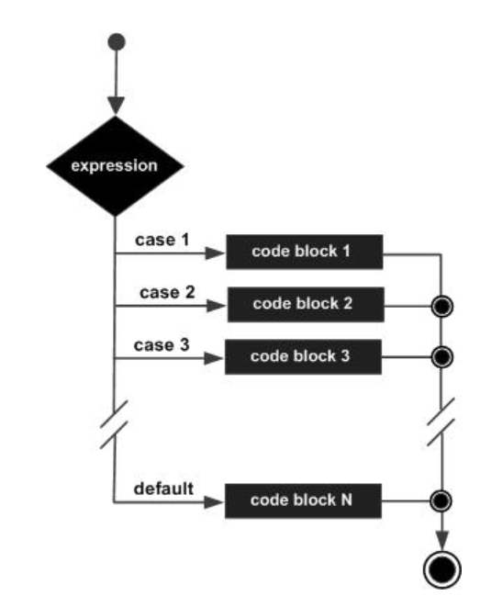
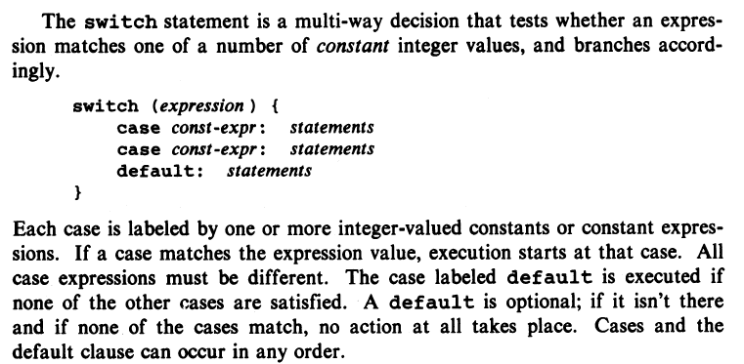
2.4 Switch
switch (grade) { case 9: printf("Freshman\n"); break; case 10: printf("Sophomore\n"); break; case 11: printf("Junior\n"); break; case 12: printf("Senior\n"); break; default: printf("Invalid\n"); break; }
The switch keyword initiates the statement and is followed by (), which contains the value that each case will compare. In the example, the value or expression of the switch statement is grade. One restriction on this expression is that it must evaluate to an integral type (int, char, short, long, long long, or enum).
Inside the block, {}, there are multiple cases. The case keyword checks if the expression matches the specified value that comes after it. The value following the first case is 9. If the value of grade is equal to 9, then the code that follows the : would run.
The break keyword tells the computer to exit the block and not execute any more code or check any other cases inside the code block.
At the end of each switch statement, there is a default statement. If none of the cases are true, then the code in the default statement will run. It’s essentially the else part. In the code above, suppose grade is equal to 10, then the output would be “Sophomore”.
Note: Without the break keyword at the end of each case, the program would execute the code for the first matching case and all subsequent cases, including the default code. This behavior is different from if / else conditional statements which execute only one block of code.
switch(expression) {
case constant-expression : statement(s);
break; /* optional */
case constant-expression :
statement(s);
break; /* optional */
/* you can have any number of case statements */
default: /* optional */
statement(s);
}

Slide 10
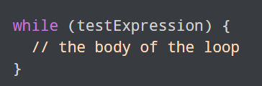
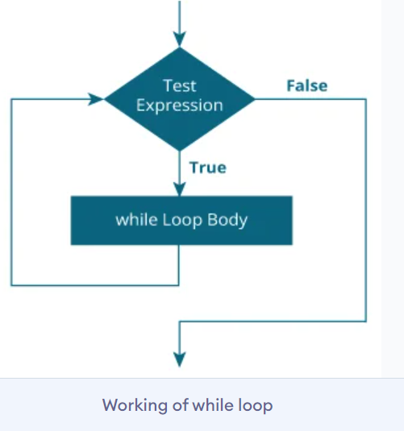
2.5 while and for
while (condition) { // Statement(s) }
In other words, instead of executing if something is true, it executes while that thing is true.
while (guess != 8) { printf("Wrong guess, try again: "); scanf("%d", &guess); }
In this example, the program will keep asking the user to input a new number while guess is not equal to 8. It will exit the while loop once the user types 8, allowing the condition to finally become false and let the program continue.

Slide 11
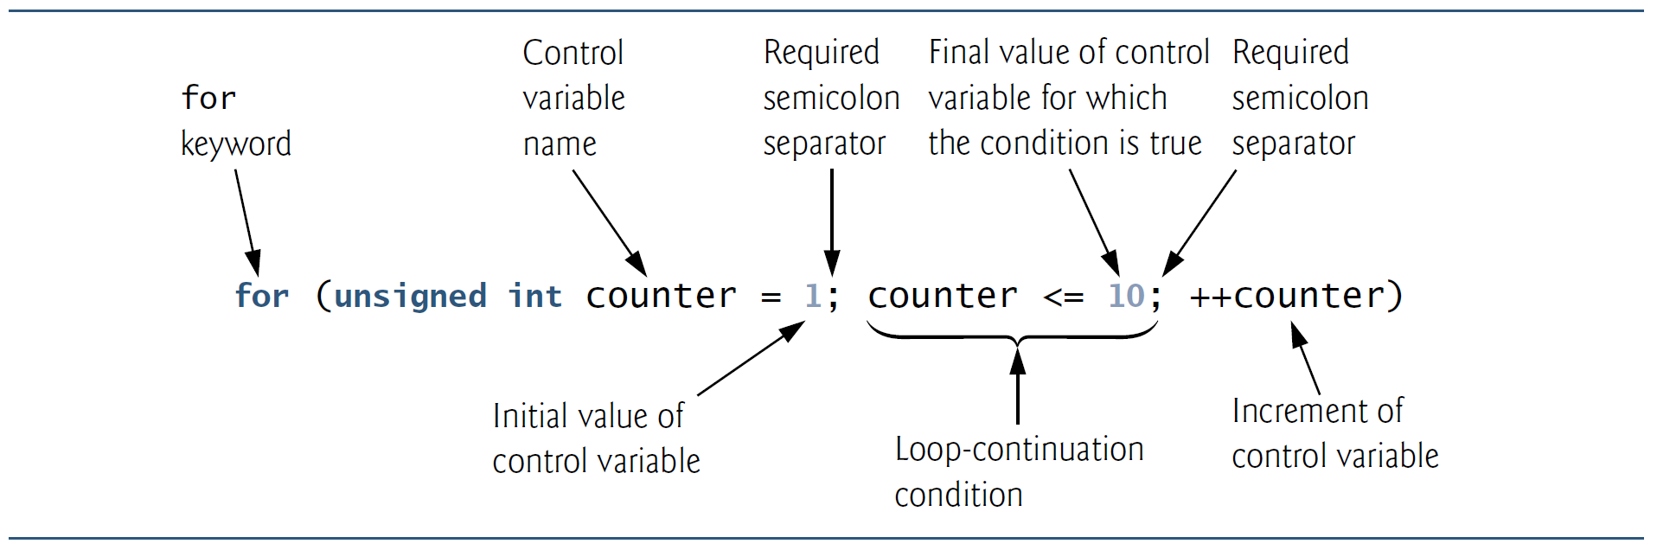
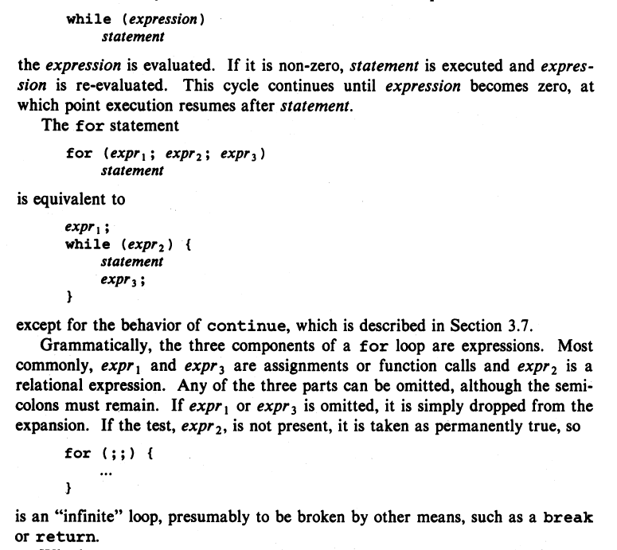
2.5 while and for
for (int i = 0; i < 10; i++) { printf("%d\n", i); }
Let’s take a closer look at the first line:
for (int i = 0; i < 10; i++)
There are three parts to this separated by two ;:
The initialization of a counter: int i = 0
The condition: i < 10
The change in the counter (in this case an increment): i++
In the first part, we create a variable i that starts from 0 and acts as our counter. In the second part, as long as our counter i is less than 10, the statements within the loop will repeatedly run. In the third and final part, after each iteration of the for loop, we add 1 to i using the ++ operator.
Or in other words, we start with some initialized variable, then while some condition is true, we do something, then we incrementally change the control variable. Does this sound familiar?
It’s just like a while loop! In fact, the above for loop does the exact same thing as the while loop we just worked with in the previous exercise!
The while loop from exercise:
int i = 0; while (i < 10) { printf("%d\n", i); i++; }
Note: This distinction is important because it allows us to switch between while loops and for loops to best fit the current program’s needs. If we don’t quite know when a loop may end, we use a while loop. If we do know exactly when a loop should end, we use a for loop.

Slide 12
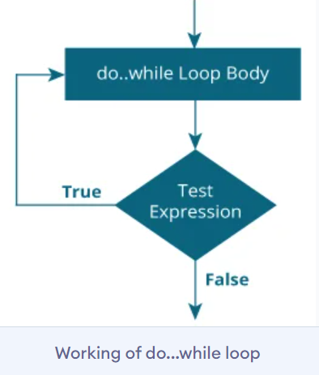
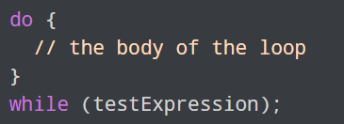
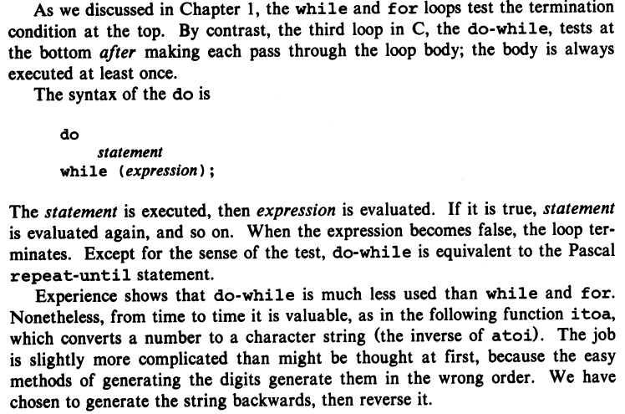
2.6 Do-while
do { // Statement(s) } while (condition);
This is odd, the condition came after the statements. Does this mean the condition isn’t checked until after the statements get executed?
That is exactly what happens!
This is what’s known as a do-while loop. Simply put, it does something first, and then checks the condition afterward and loops in this manner until the condition is no longer true.
The do-while loop is most often used when a program wants to do something at least once before checking the condition.

Slide 13
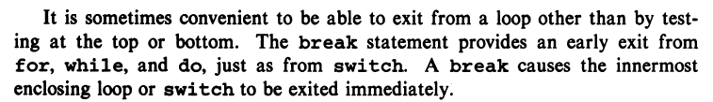
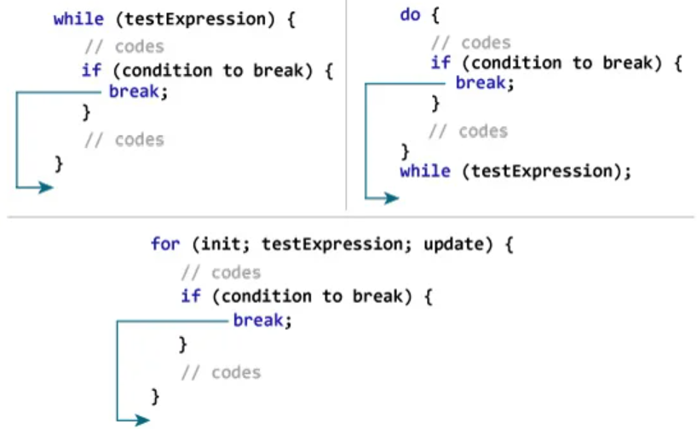
3.7 Break and Continue
while (tries < 50) { scanf("%d", &guess); if (guess == 8) { break; } printf("Wrong guess, try again: "); tries++; }
The keyword break allows us to, quite literally, “break” out of a loop and stop it from running any more times.
It can often simply be avoided with careful planning of the conditional controlling a loop. It’s generally advised to be careful with breaking out of loops because it can result in unexpected processing when a programmer has a mental plan centered around a loop finishing all its iterations.
However, when used effectively, a break can increase the efficiency of a program and help minimize its memory uses through unnecessary variables.
Note: break is most often used when a program wants to run a loop infinitely in a controlled manner. For example, a program that runs until the user types “quit.” In that instance, the program may run forever, but will only break out of its running loop when the user tells it.

Slide 14
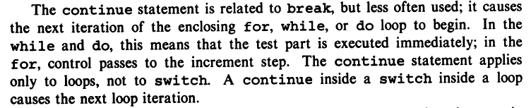
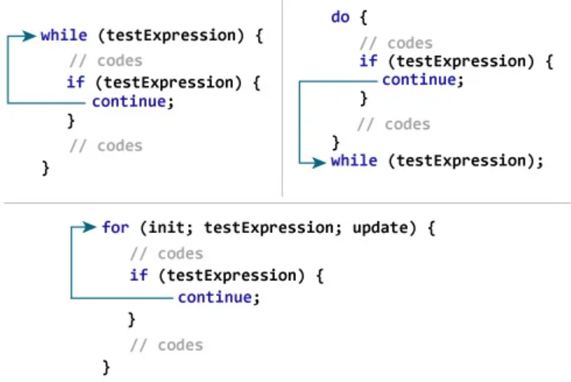
3.7 Break and Continue
In a loop, if a continue is ever reached, it will immediately skip the rest of the statements inside the loop body and “continue” into the next iteration.
For example, let’s look at the following syntax:
for (int i = 0; i < 10; i++) { if (i % 2 == 0) { continue; } printf("%d is odd\n", i); }
Inside the for loop, we see an if statement checking if the current counter, i, is an even number by using the % operator. If i is even, continue to the next iteration and skip the print statement below. If i is odd, print i and continue as normal.
Note: These keywords can still affect a loop even if they’re contained inside an if statement. This means a continue will always advance to the next iteration even if it’s nested in multiple if / else statements! This goes for other loop keywords as well, like break. If there are nested loops, a keyword will only interact with the most interior loop it is contained in.

Slide 15
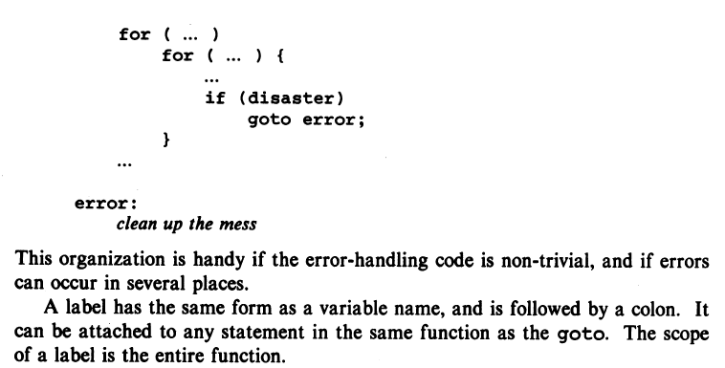
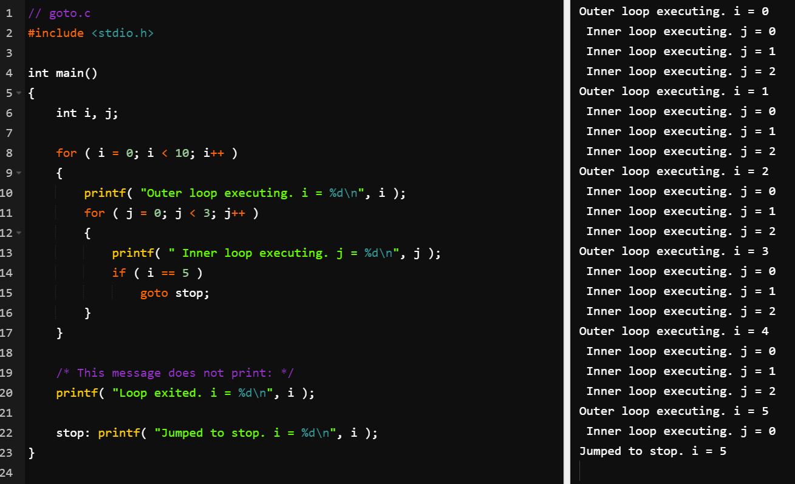
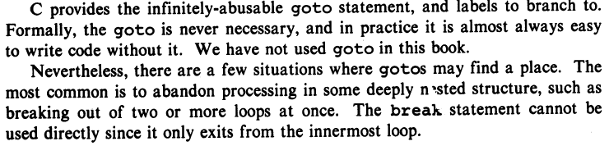
2.8 Goto and Labels
Notes:
// goto.c
#include <stdio.h>
int main()
{
int i, j;
for ( i = 0; i < 10; i++ )
{
printf( "Outer loop executing. i = %d\n", i );
for ( j = 0; j < 3; j++ )
{
printf( " Inner loop executing. j = %d\n", j );
if ( i == 5 )
goto stop;
}
}
/* This message does not print: */
printf( "Loop exited. i = %d\n", i );
stop: printf( "Jumped to stop. i = %d\n", i );
}

Slide 16

References
Each Reference is indicated on the footer on each slide.
Books:
The_C_Programming_Language_(2nd_Edition_Ritchie_Kernighan)
Learn to Program with C_ Learn to Program using the Popular C Programming Language (Noel Kalicharan)
C How to Program, 8th edition, Paul Deitel and Harvey Deitel, Pearson, 2016.

Slide 17


Thank You
Nazrin Dolkhanova Sultanli
Nazrin.Sultanli.Dolkhanova@bhos.edu.az
Baku Higher Oil School

